Slide 1
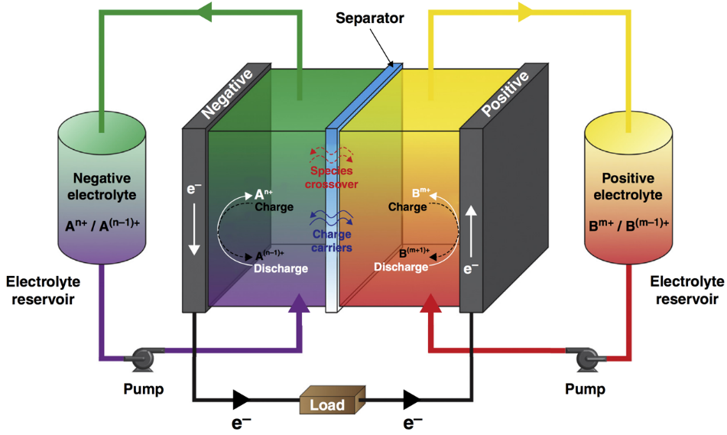
Redox Flow Battery (RFB) as a Stationary Energy Storage System
Advantages:
Separation of energy and power capacity
Integration of intermittent renewable energy sources into the electrical grid
Non-aqueous RFBs potentially yield high energy density and lower cost
Kowalski, Su, Milshtein, Brushett (2016) Current Opinion in Chemical Engineering

Slide 2
Electrode Passivation by Damaged Redoxmers
E.g.:
=
Normal redox cycling
Electrode

Slide 3
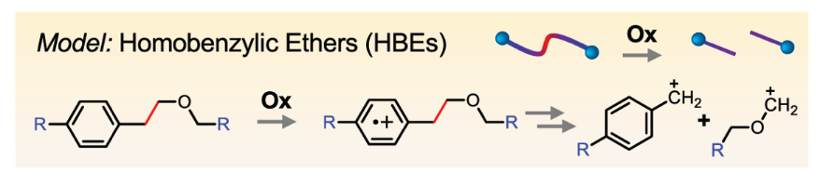
Designing Backbone with Cleavable Tethers
E.g.:
=
Normal redox cycling
Programmed
redox trigger
Electrode
Qian, Counihan, Doan, Danis, Setwipatanachai, Purwanto, Rodríguez-López, Assary, Moore. 2020. Under review.
Programmable redox triggered fragmentation removes deposits from electrodes and regenerate active redoxmers

Slide 4
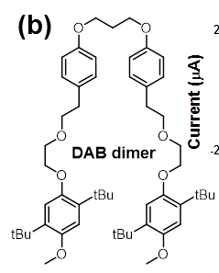
Designing Backbone with Cleavable Tethers
E.g.:
=
Desirable HBEs’ properties:
Suitable redox potential windows
Favorable mesolytic cleavage pathways
High solubility
Ease of synthesis
Electrochemical reversibility
Desirable HBEs’ properties:
Suitable redox potential windows
Favorable mesolytic cleavage pathways
High solubility
Ease of synthesis
Electrochemical reversibility
Normal redox cycling
Programmed
redox trigger
Electrode
=
Qian, Counihan, Doan, Danis, Setwipatanachai, Purwanto, Rodríguez-López, Assary, Moore. 2020. Under review.
Programmable redox triggered fragmentation removes deposits from electrodes and regenerate active redoxmers

Slide 5
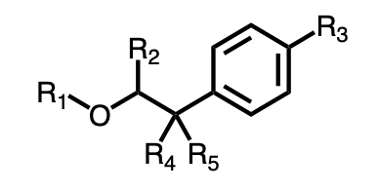
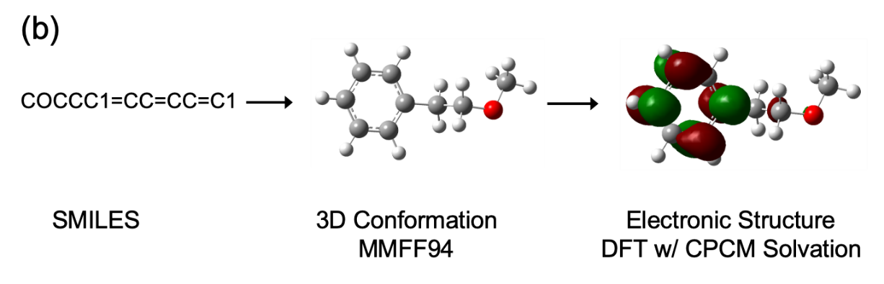

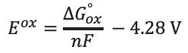
HBE database generation and E^{Ox} evaluation
SMILES (Simplified Molecular-Input Line Entry System)
$$\sim$$
﻿[R3]C1=CC=C(C([R4])([R5])C([R2])-[O][R1])C=C1
R₁ = -Me, -Et, -Pr, -Ph, -CN, -Eth, -COMe,
R₂ = -H, -Me, -Ph, -OMe, -Br, -CN
R₃ = -H, Et, -OMe, -N(Me)₂, -CN, -NO₂, -COOMe, -Ph
R₄ , R₅ = -H, -Me, -Ph, CN
> 1000 HBEs
$$E^{ox}=\frac{∆G_{ox}^{°}}{nF} −4.28 V$$

Slide 6
Finding needle in the haystack!

